Slide 1
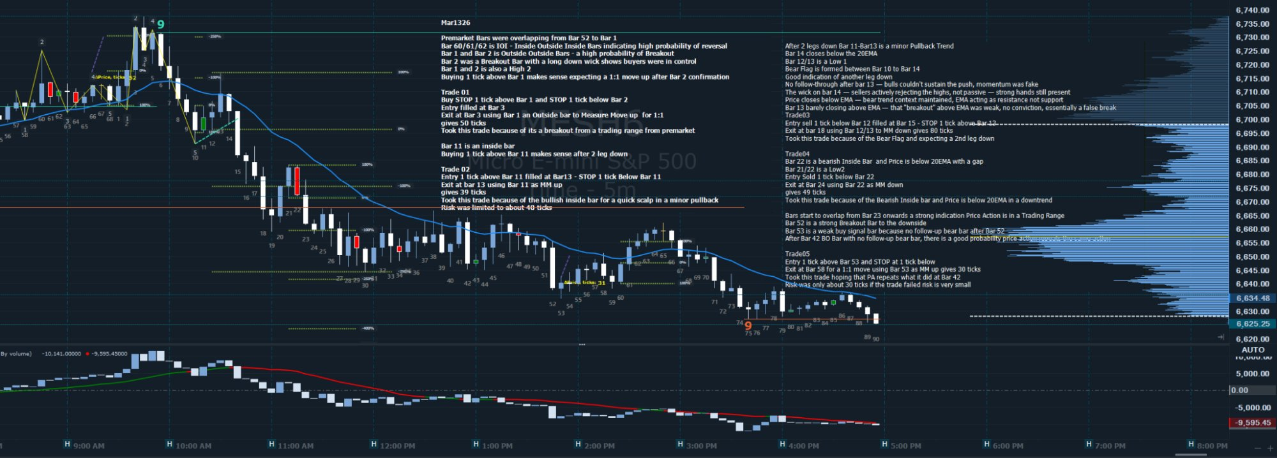



EOD REVIEW · MES · 5-Minute Bars
Mar 13, 2026
PRE-MARKET CONTEXT
Bars 52–1 overlapping (IOI pattern) → high probability reversal · Bar 2 = Outside Outside Bar (Breakout) · Bar 2 has long lower wick → buyers in control · Bars 1 & 2 = High 2 · Expect 1:1 move up after Bar 2 confirmation
T01
LONG
T02
LONG
T03
SHORT
T04
SHORT
T05
LONG
Bars 1–3
Bars 11–13
Bars 12–18
Bars 22–24
Bars 53–58
ENTRY
+39 ticks
ENTRY
+39 ticks
ENTRY
+80 ticks
ENTRY
+49 ticks
ENTRY
+30 ticks
Buy STOP 1 tick above Bar 1 · STOP 1 tick below Bar 2
Buy STOP 1 tick above Bar 11 filled at Bar 13 · STOP 1 tick below Bar 11
Sell STOP 1 tick below Bar 12 filled at Bar 15 · STOP 1 tick above Bar 12
Sell STOP 1 tick below Bar 22 · Entry Bar 21/22 = Low 2
Buy STOP 1 tick above Bar 53 · STOP 1 tick below Bar 53
EXIT
EXIT
EXIT
EXIT
EXIT
Exit Bar 3 using Bar 1 as Outside Bar to measure move · 1:1R
Exit Bar 13 using Bar 11 as MM up · 39 ticks
Exit Bar 18 using Bar 12/13 MM down · 80 ticks
Exit Bar 24 using Bar 22 as MM down · 49 ticks
Exit Bar 58 at 1:1 MM using Bar 53 · 30 ticks
REASON
REASON
REASON
REASON
REASON
Breakout from pre-market trading range · Bar 2 BOO
Bar 11 = inside bar · Bullish scalp after 2-leg pullback
Bear Flag Bars 10–14 · Expecting 2nd leg down · Bar 13 = Low 1
Bearish inside bar · Price below 20 EMA with gap · Downtrend context
Bar 52 = strong BO bar down · Bar 53 = weak buy signal · PA repeating Bar 42 pattern
EOD Review: March 13, 2026 · MES 5m · Personal trade journal — not financial advice

Slide 2
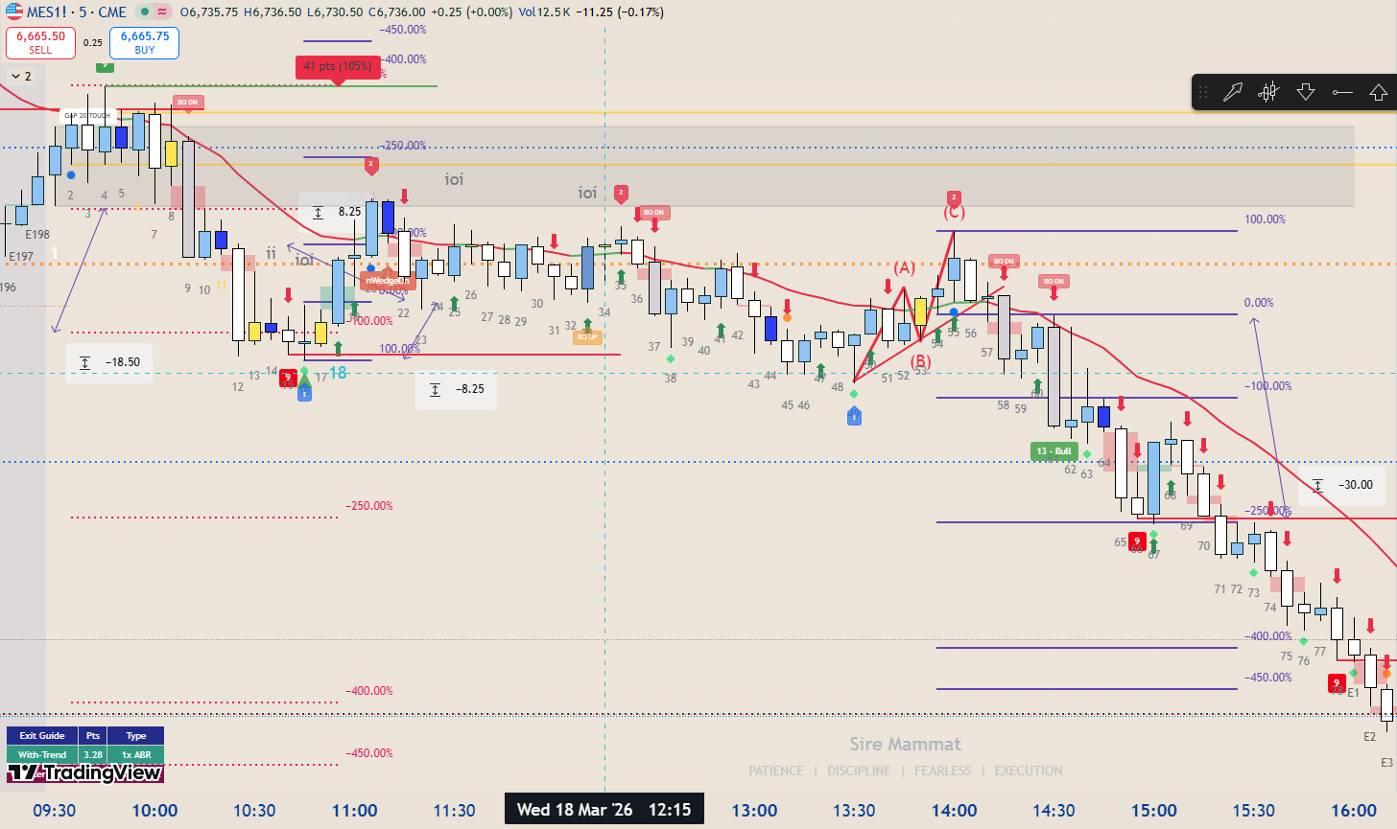
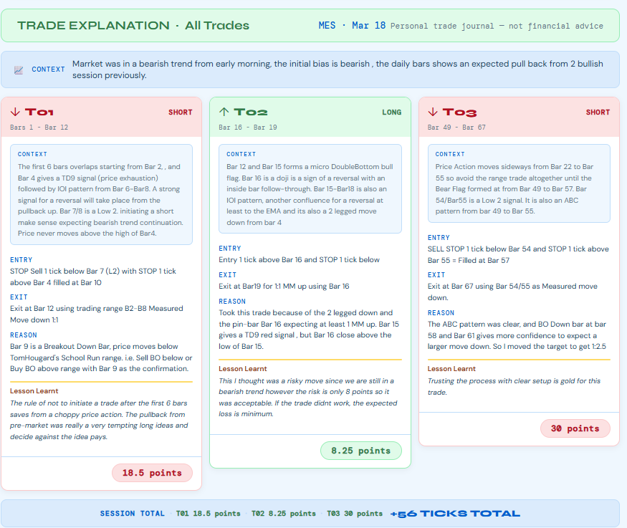

Slide 3
SESSION NOTES · MES 5m · Mar 13, 2026
Bar-by-Bar Context
Early Session · Bars 1–14
Mid Session · Bars 21–53
Key Observations · All Session
Bars 52→1: Pre-market bars overlapping (IOI) — high probability reversal zone
Bar 21/22: Low 2 — bearish inside bar, price below 20EMA with gap
Structure: Early session: Trending. Mid session: Trading Range from Bar 23 onwards
Bar 60/61/62: IOI pattern — Inside Outside Inside Bars confirming reversal
Price vs EMA: Price closes below EMA — bear trend context, EMA acting as resistance not support
EMA role: EMA acted as resistance in the afternoon — price unable to sustain above
Bar 2: Outside Outside Bar (breakout bar) with long lower wick — buyers in control
Bar 22: Bearish inside bar confirmed — entry sell stop 1 tick below
Bear Flag: Classic Bear Flag Bars 10–14 led cleanly to T03 — 80 tick winner
Bars 1 & 2: High 2 structure — buying 1 tick above Bar 1 makes sense
Bars 23+: Bars start to overlap — strong indication price action is in a Trading Range
Pattern repeat: Bar 53 setup mirrors Bar 42 — trading pattern recognition
Bar 11: Inside bar — buying 1 tick above makes sense after 2-leg pullback
Bar 52: Strong Breakout Bar to the downside
T02 note: Risk was limited to ~40 ticks — bullish inside bar scalp in minor pullback
Bar 12/13: Low 1 — bear trend continuation signal
Bar 53: Weak buy signal bar — no follow-up bear bar after Bar 52
T03 conviction: Took trade for Bear Flag + expecting 2nd leg down — confirmed by Bar 13 Low 1
Bars 10–14: Bear Flag forming — good indication of another leg down
After Bar 42: BO Bar with no follow-up bear bar — high probability price repeats pattern from Bar 42
T04 context: Downtrend confirmed — bearish inside bar below EMA with gap is high conviction
Bar 13: No follow-through after bulls couldn't sustain push — momentum fake
Risk note: T05 risk was only about 30 ticks — very small if trade failed
Walk away: No T06 — overlapping bars from Bar 23 signal choppy range. Correct to stop.
Bar 14: Wick on bar 14 — sellers actively rejecting highs, strong hands present
SESSION RESULT · 5 Trades · T01 +39 · T02 +39 · T03 +80 · T04 +49 · T05 +30 · TOTAL: +237 TICKS
Bar 13 (EMA): Barely closing above EMA — "breakout" above EMA weak, essentially a false break

Slide 4

TRADE EXPLANATION DATE
Overall Context
T01
LONG
T02
LONG
T03
SHORT
T04
SHORT
T05
LONG
Bars 1–3
Bars 11–13
Bars 12–18
Bars 22–24
Bars 53–58
CONTEXT:
ENTRY
CONTEXT:
ENTRY
CONTEXT:
Buy STOP 1 tick above Bar 11 filled at Bar 13 · STOP 1 tick below Bar 11
Bars 10–14: Bear Flag forming — good indication of another leg down
Sell STOP 1 tick below Bar 22 · Entry Bar 21/22 = Low 2
Bar 52: Strong Breakout Bar to downside
EXIT
Bar 12/13: Low 1 — bear trend continuation signal
EXIT
Bar 53: Weak buy signal — no follow-up bear bar after Bar 52
Exit Bar 13 using Bar 11 as MM up · 39 ticks
Bar 13: No follow-through from bulls — momentum was fake
Exit Bar 24 using Bar 22 as MM down · 49 ticks
Bar 42 pattern: BO Bar earlier in session had no follow-through — same setup repeating
Bar 14: Wick rejecting highs — sellers actively in control
Risk: Only ~30 ticks — very small if trade failed
REASON
Bar 13 vs EMA: Barely closes above EMA — essentially a false break
REASON
ENTRY
Bar 11 = inside bar · Bullish scalp after 2-leg pullback
Bearish inside bar · Price below 20EMA with gap · Downtrend context
ENTRY
ENTRY
Buy STOP 1 tick above Bar 53 · STOP 1 tick below Bar 53
EXIT
+39 ticks
Sell STOP 1 tick below Bar 12 filled at Bar 15 · STOP 1 tick above Bar 12
+49 ticks
EXIT
Lesson Learnt
EXIT
Lesson Learnt
Exit Bar 58 at 1:1 MM using Bar 53 · 30 ticks
REASON
Inside bars at the end of a 2-leg pullback in a trending session are clean scalp entries. Keep risk tight — the inside bar naturally defines the stop.
Exit Bar 18 using Bar 12/13 MM down · 80 ticks
Bearish inside bars below EMA with a visible gap are textbook downtrend continuation entries. EMA gap = trend momentum. Low 2 adds structural confluence. Core SIMPAN setup.
REASON
REASON
Bar 52 strong BO bar with no follow-through · PA repeating Bar 42 pattern
Bear Flag Bars 10–14 · Expecting 2nd leg down · Bar 13 Low 1 confirmation
+30 ticks
+80 ticks
Lesson Learnt
Lesson Learnt
Lesson Learnt
When a strong BO bar has no follow-through, the move may be exhausted. Pattern recognition within the same session is a valid edge — if Bar 42 showed the same setup and worked, Bar 53 deserves the trade at minimal risk.
Bear Flags with a Low 1 at the flag top are highest conviction short setups. Fake EMA breakout on Bar 13 with no follow-through was the final signal. When wick rejection and false EMA breakout align — high conviction entry.
SESSION TOTAL · T01 +39 · T02 +39 · T03 +80 · T04 +49 · T05 +30 · +237 TICKS

Slide 5
TRADE EXPLANATION DATE
Overall Context
T01
LONG
Bars
Based on my inputs
So if I enter Long this will be long vice versa
ENTRY
EXIT
REASON
Lesson Learnt

Slide 6
TRADE EXPLANATION · All 5 Trades · MES 5m · Mar 13, 2026
CONTEXT · IOI pre-market compression · Bar 2 OOO breakout · High 2 structure · VWAP above = bullish bias · Bear Flag Bars 10–14 · Low 1 Bar 12/13 · Bars 23+ overlap = Trading Range
T01
LONG
T02
LONG
T03
SHORT
T04
SHORT
T05
LONG
Bars 1–3
Bars 11–13
Bars 12–18
Bars 22–24
Bars 53–58
CONTEXT: Bars 52→1: Pre-market bars overlapping (IOI) — high probability reversal zone
Bar 2: Outside Bar (breakout bar) with long lower wick — buyers in control
Bars 1 & 2: High 2 structure — buying 1 tick above Bar 1 makes sense
Bar 60/61/62: IOI pattern — Inside Outside Inside Bars confirming reversal
ENTRY
CONTEXT:
ENTRY
CONTEXT:
Buy STOP 1 tick above Bar 11 filled at Bar 13 · STOP 1 tick below Bar 11
Bars 10–14: Bear Flag forming — good indication of another leg down
Sell STOP 1 tick below Bar 22 · Entry Bar 21/22 = Low 2
Bar 52: Strong Breakout Bar to downside
EXIT
Bar 12/13: Low 1 — bear trend continuation signal
EXIT
Bar 53: Weak buy signal — no follow-up bear bar after Bar 52
Exit Bar 13 using Bar 11 as MM up · 39 ticks
Bar 13: No follow-through from bulls — momentum was fake
Exit Bar 24 using Bar 22 as MM down · 49 ticks
Bar 42 pattern: BO Bar earlier in session had no follow-through — same setup repeating
Bar 14: Wick rejecting highs — sellers actively in control
Risk: Only ~30 ticks — very small if trade failed
REASON
Bar 13 vs EMA: Barely closes above EMA — essentially a false break
REASON
ENTRY :
Buy STOP 1 tick above Bar 1 · STOP 1 tick below Bar 2
Bar 11 = inside bar · Bullish scalp after 2-leg pullback
Bearish inside bar · Price below 20EMA with gap · Downtrend context
ENTRY
ENTRY
Buy STOP 1 tick above Bar 53 · STOP 1 tick below Bar 53
+39 ticks
Sell STOP 1 tick below Bar 12 filled at Bar 15 · STOP 1 tick above Bar 12
+49 ticks
EXIT
EXIT: At Bar 3 using Bar 1 as Outside Bar to measure move up
EXIT
Exit Bar 58 at 1:1 MM using Bar 53 · 30 ticks
REASON : Breakout from pre-market trading range · Bar 2 = OO expecting 1:1R minimum
Lesson Learnt
Exit Bar 18 using Bar 12/13 MM down · 80 ticks
Lesson Learnt
Inside bars at the end of a 2-leg pullback in a trending session are clean scalp entries. Keep risk tight — the inside bar naturally defines the stop.
Bearish inside bars below EMA with a visible gap are textbook downtrend continuation entries. EMA gap = trend momentum. Low 2 adds structural confluence. Core SIMPAN setup.
REASON
REASON
Bar 52 strong BO bar with no follow-through · PA repeating Bar 42 pattern
+39 ticks
Bear Flag Bars 10–14 · Expecting 2nd leg down · Bar 13 Low 1 confirmation
+30 ticks
Lesson Learnt: IOI pre-market compression followed by a strong Outside Bar breakout is a high-probability setup. The long lower wick on Bar 2 was the key confirmation — buyers were aggressively defending. Wait for Bar 2 close confirmation before entering.
+80 ticks
Lesson Learnt
Lesson Learnt
When a strong BO bar has no follow-through, the move may be exhausted. Pattern recognition within the same session is a valid edge — if Bar 42 showed the same setup and worked, Bar 53 deserves the trade at minimal risk.
Bear Flags with a Low 1 at the flag top are highest conviction short setups. Fake EMA breakout on Bar 13 with no follow-through was the final signal. When wick rejection and false EMA breakout align — high conviction entry.
SESSION TOTAL · T01 +39 · T02 +39 · T03 +80 · T04 +49 · T05 +30 · +237 TICKS

